Slide 1



learn invent impact
Logarithmic Reduction of Algorithmic Complexity
Enumerating vs. Counting Control Paths
Suresh C. Kothari
Professor, Department of Electrical and Computer Engineering
President & Founder EnSoft Corp.
Acknowledgement: Team members at Iowa State University and EnSoft, DARPA contracts FA8750-12-2-0126 & FA8750-15-2-0080

Slide 2
An overview
Program
Mapping/Indexing
Atlas Visualization
Graph traversal using Atlas eDSL
Atlas query
Successor Relation
Execution Behaviors
Universal Graph
CFG
Computing the execution behaviors requires enumerating paths in CFGs
Enumerate means produce the paths one by one.
We shall first develop the enumeration algorithm for acyclic CFGs and later find a way to model loops so that the algorithm can be extended to all CFGs.

Slide 3
Remarks on Enumeration Algorithm
Importance of enumerating paths: Execution behaviors can be deduced from paths
Importance of the total path count: It reflects the complexity of software in terms of the number paths
Algorithmic complexity of enumeration algorithm: It is of the order of number paths, which makes it exponential complexity with respect to (E+V) where E is the number of edges and V is the number of nodes in the graph
Important questions for next lectures:
Is there an efficient algorithm to count paths with non-exponential complexity?
What to do take care of loops?
This lecture is about an important concepts and its use in a novel path counting algorithm that has linear complexity.
Algorithmic Complexity Reduction: Exponential to Linear

Slide 4
Enumerating vs. Counting
Preamble: A set S with some kind of elements; in our application it is a set of paths in a directed graph.
Enumerating: List each element of S individually; the elements can be counted while listing.
Counting: Get the total number of elements in S.
Algorithmic complexity of Enumerating vs. Counting:
Enumerating: The complexity is of the order of number of elements in S.
Counting: We shall discuss a smart path counting algorithm for which the complexity is smaller by a logarithmic factor (i.e., 2^{n} paths get counted in n steps.)

Slide 5
A note about problems with underlying graphs
Massively Connected System Problems
Underlying Graphs
Challenge of Solving the Problems: The problems involve one or more practically infinite sets
Example: Software is a massively connected system. Cybersecurity problems are about practically infinite set of execution behaviors of software.
Efficient Solution:
Algebra
Graph
Matrix
Mathematical concept dodges Infinite Set
Problem
Computable problem
Practically Infinite Set

Slide 6
From the course prologue
Contrary to the common belief, mathematics is less about writing proofs and more about uncovering the real problem and discovering concepts that bring the necessary clarity to go to the heart of problem – without the right concepts we cannot solve hard problems.
This course offers and embodies a novel way of thinking that leads to discovering concepts to solve hard software problems.
Hence it is both challenging and interesting, and perhaps to some of you inspiring and life changing too.

Slide 7
Logarithmic Reduction of Algorithmic Complexity
The number of paths grows exponentially in relation to the number of edges plus nodes (E+V). The enumeration algorithm has algorithmic complexity of the order of the number of paths. The algorithm presented in this lecture reduces the complexity logarithmically and achieves linear complexity in relation to (E+V). This drastic reduction makes it possible to count paths for CFGs in real world software.
2^{(E+V)}
Complexity of enumeration algorithm
E+V
2^{(E+V)}
nodes + Edges
Paths
Log(2^{(E+V)}) = E+V
Complexity of multiplicity algorithm
Enabled by a new concept – Multiplicity

Slide 8
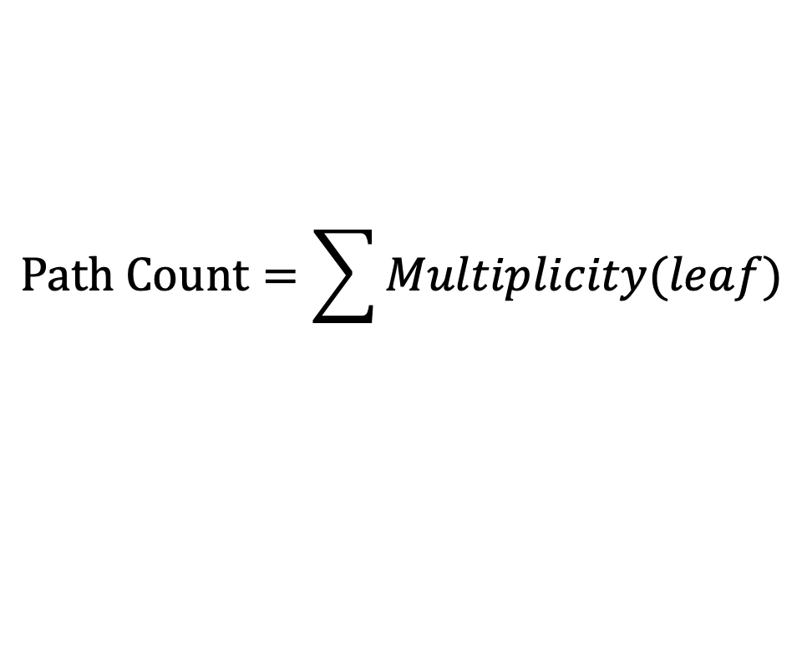
Concept: Multiplicity of a node
Definition: The multiplicity of a node X is the total number of paths from root to X.
1
2
1
3
1
4
Why is multiplicity an important concept?
1
5
$$Path Count=\sum{Multiplicity(leaf)}$$
1
6
2
8
9
2
Efficient algorithm for counting the paths if we have an efficient algorithm to compute the multiplicities of nodes in a graph
2
15
2
10
12
2
17
6

Slide 9
Multiplicity Examples
C1
1
A
A
C2
1
X1
X2
1
B
C
a1
B
2
a2
C3
2
Y1
Y2
2
D
C
4
X
a3
a4
Y
4
Z1
Z2
4
C4
8
D
Z
a5
a6

Slide 10
A simple principle for computing multiplicities
Multiplicities come from predecessors of X
p
q
Important point: X should propagate multiplicities only after it has received multiplicity from each of its predecessors
Node: X
Multiplicity(X) = p + q
Notation:
M(X) = Multiplicity of X
R_{f}(X) = Remaining Predecessors from which X has
not received multiplicity.
Initialization: R_{f}(X) = # Predecessors of X
Multiplicity(X) is propagated to successors of X

Slide 11
Why is the complexity reduced?
Suppose 10 paths reach X
Multiplicity Algorithm
Each edge is traversed once
Node: X
e
Notation: M(X) = Multiplicity of X
Leaf: L
Enumeration Algorithm
The edge e is traversed 10 times

Slide 12
How many times an edge e is traversed?
C1
1
A
A
C2
1
X1
X2
1
B
C
a1
B
2
a2
C3
2
Y1
Y2
2
D
C
4
X
a3
a4
Y
Z1
Z2
4
e
4
e
C4
8
D
e
Z
a5
a6
The number of times an edge e is traversed = Multiplicity of the tail node of e

Slide 13
A simple modification of enumeration algorithm?
Let’s explore if there is a simple modification of the enumeration algorithm to use the concept of multiplicity.
Suppose 10 paths reach X
Idea: Stop the forward pass at X until it has received multiplicity from its predecessors
The stop criterion for forward pass should be changed
Node: X
Stop Criterion: Leaf OR (R_{f} > 0); R_{f} = 0 when all multiplicities are received
e
Question: Should the backward pass remain the same?
Leaf: L
Time for experiments with examples !!

Slide 14
Pseudocode for the enumeration algorithm
Start:
Start at the root of CFG with empty partial part
Pre: We are at some node P and path = some path reaching node P
Forward loop(k): Iterate on node k, initially k = P
Criterion to stop the loop: k is leaf (L)
Loop Body:
Increment path: Append to path the edge from k to the successor(k). If k is a branch successor(k) = successor-1(k), add the 1-edge from k and set B_{f}(k) = 1
k = successor(k)
Post: Write the path which starts from root and has reached leaf (L). Increment the path counter.
Should Change
Forward:
Pre: We are at a leaf = L and the path is a path from root to L
Backward loop(k): Iterate on node k, initially k = L
Criterion to stop the loop: B_{f}(k) == 1
Decrement path: Remove from the path the last edge (the edge from from k to its predecessor on the path)
k = predecessor(k)
Post: Set B_{f}(k) = 0. Append 0-edge of k to path, k = 0-successor(k).
Backward:
Termination:
Backward step at #4, terminate if you do not reach a node k with B_{f}(k) == 1

Slide 15
Modification of the forward pass
Pre: We are at some node P and path = some path reaching node P
Forward loop(k): Iterate on node k, initially k = P
Criterion to stop the loop: k is leaf OR R_{f}(k) > 0
Loop Body:
Increment path: Append to path the edge from k to the successor(k). If k is a branch successor(k) = successor-1(k), add the 1-edge from k and set B_{f}(k) = 1
M(successor(k)) = M(successor(k)) + M(k)
R_{f}(successor(k)) = R_{f}(successor(k)) - 1
k = successor(k)
Post: Write the path which starts from root and has reached leaf (L). Increment the path counter.

Slide 16
Multiplicity Algorithm – Example 1
F1: Path = 2, 3, 4, 5, 6, 8
B_{f}(5) = 1, R_{f}(8) = 1, M(8) = 1
2
B1: Path = 2, 3, 4, 5, 8
B_{f}(5) = 0, R_{f}(8) = 0, M(8) = 2
B should update M(8) and R_{f}(8)
3
F2: Path = 2, 3, 4, 5, 6, 8, 9, 10, 17
B_{f}(8) = 1, B_{f}(9) = 1, R_{f}(17) = 2, M(17) = 2
4
B2: Path = 2, 3, 4, 5, 6, 8, 9, 12
B_{f}(8) = 1, B_{f}(9) = 0, R_{f}(17) = 2, M(17) = 2
1
5
F3: Path = 2, 3, 4, 5, 6, 8, 9, 12, 17
B_{f}(8) = 1, B_{f}(9) = 0, R_{f}(17) = 1, M(17) = 4
6
0
B3: Path = 2, 3, 4, 5, 8, 15
B_{f}(8) = 0, B_{f}(9) = 0, R_{f}(17) = 1, M(17) = 4
8
1
F4: Path = 2, 3, 4, 5, 8, 15,17
B_{f}(8) = 0, B_{f}(9) = 0, R_{f}(17) = 0, M(17) = 6
0
9
15
1
0
B4: Path = empty, Termination
10
12
17

Slide 17
Experimental Observation - 1
F1: Path = 2, 3, 4, 5, 6, 8
B_{f}(5) = 1, R_{f}(8) = 1, M(8) = 1
2
B1: Path = 2, 3, 4, 5, 8
B_{f}(5) = 0, R_{f}(8) = 0, M(8) = 2
B should update M(8) and R_{f}(8)
3
4
B1 back tracks to 5, sets B_{f}(5) = 0, appends 0-edge from 5 to 8 which is successor-0(5)
5
Two implications
1
Backward should update the multiplicity of the head of the edge it adds
In this example: Update the multiplicity of 8
6
0
8
1
0
Backward should update the R_{f} of the head of the edge it adds
In this example: Update R_{f}(8)
9
15
1
0
10
12
17

Slide 18
Multiplicity Algorithm – Example 2
F1: Path = A, X1, B
B_{f}(A) = 1, R_{f}(B) = 1, M(B) = 1
1
A
0
X1
B1: Path = A, X2
B_{f}(A) = 0, R_{f}(B) = 1
X2
B
0
F2: Path = A, X2, B, Y1, C
B_{f}(B) = 1, R_{f}(B) = 0, R_{f}(C) = 1, M(B) = 2, M(C) = 2
1
Y1
Y2
B2: Path = A, X2, B, Y2
B_{f}(B) = 0, R_{f}(B) = 1, R_{f}(C) = 0
1
C
0
F3: Path = A, X2, B, Y2, C, Z1, D
B_{f}(C) = 1, R_{f}(B) = 0, R_{f}(C) = 0, R_{f}(D) = 1, M(B) = 2, M(C) = 4, M(D) = 4
Z1
Z2
B3: Path = A, X2, B, Y2, C, Z2,
B_{f}(C) = 0, R_{f}(B) = 0, R_{f}(C) = 0, R_{f}(D) = 1, M(B) = 2, M(C) = 4, M(D) = 4
D
F4: Path: A, X2, B, Y2, C, Z2, D
B_{f}(C) = 0, R_{f}(B) = 0, R_{f}(C) = 0, R_{f}(D) = 0, M(B) = 2, M(C) = 4, M(D) = 8
B4: Path = Empty, Termination

Slide 19
Multiplicity Algorithm – Example 3
F1: Path = A, B, X
B_{f}(A) = 1, B_{f}(B) = 1, R_{f}(X) = 1, M(X) = 1
A
1
0
B1: Path = A, B, D
B_{f}(A) = 1, B_{f}(B) = 0, R_{f}(X) = 1, R_{f}(D) = 1, M(X) = 1, M(D) = 1
B
C
F2: Path = A, B, D
Forward loop does not iterate
1
0
1
0
D
B2: Path = A, C
B_{f}(A) = 0, R_{f}(X) = 1, R_{f}(D) = 1, M(C) =1, R_{f}(C) =0
1
0
X
Y
F3: Path = A, C, D, X, Z
B_{f}(C) = 1, B_{f}(D) = 1, R_{f}(X) = 0, R_{f}(D) = 0, M(X) = 3, M(D) = 2, M(Z) =3
B3: Path = A, C, D, Y
B_{f}(C) = 1, B_{f}(D) = 0, R_{f}(Y) = 1, M(X) = 3, M(D) = 2, M(Y) = 2, M(Z) = 3
Z
F4: Path: A, C, D, Y
Forward loop does not iterate
B4: Path = A, C, Y
B_{f}(C) = 0, R_{f}(Y) = 0, M(X) = 3, M(Y) = 3, M(Z) = 3
F5: Path: A, C, Y, Z
B_{f}(C) = 0, R_{f}(Y) = 0, M(X) = 3, M(Y) = 3, M(Z) = 6
B5: Path = empty, Termination

Slide 20
Experimental Observation - 2
F1: Path = A, B, X
B_{f}(A) = 1, B_{f}(B) = 1, R_{f}(X) = 1, M(X) = 1
A
1
0
B1: Path = A, B, D
B_{f}(A) = 1, B_{f}(B) = 0, R_{f}(X) = 1, R_{f}(D) = 1, M(X) = 1, M(D) = 1
B
C
F2: Path = A, B, D
Should continue to X?
1
0
1
0
D
1
0
X
Y
Z

Slide 21


a₁ = 1
The Reduction of Complexity through Discovery – a video lecture by a high schooler:
a₂ = 1
https://www.youtube.com/watch?v=z_dWY1PMRrY
a₃ = 2
a₄ = 3
a₅ = 5
a₆ = 8
logarithmic reduction
$$a_{n}=a_{n−1}+a_{n−2}$$
Requires n additions
log(n) additions
$$a_{2^{n}}=a_{2^{n}−1}+a_{2^{n}−2}$$
logarithmic reduction
Requires 2^{n} additions
n additions
Smart algorithm to reduce the Fibonacci Sequence computation logarithmically?

